Slide 1
TR-069/TR-369 APIs
Update: 2023/Dec/12

Slide 2
RESTful API
A REST(Representational State Transfer. As know as RESTful) API is an architectural style for an application program interface (API) that uses HTTP requests to access and use data.
A RESTful API uses existing HTTP methodologies defined by the RFC 2616 protocol, such as:
GET to retrieve a resource;
PUT to change the state of or update a resource, which can be an object, file or block;
POST to create that resource; and
DELETE to remove it.

Slide 3
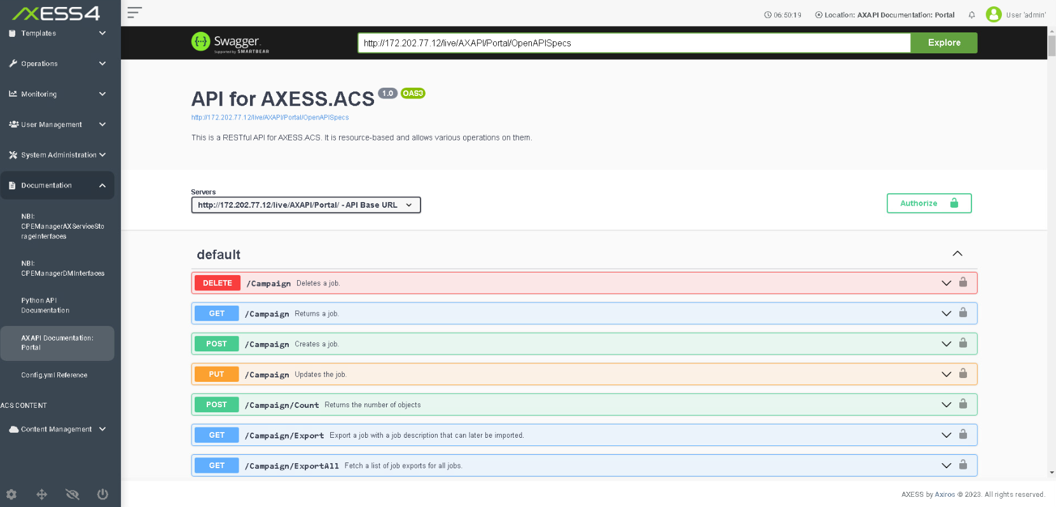
AXESS4 AXAPI

Slide 4
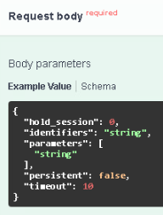
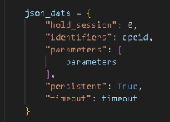
Access RESTful API in Python
HTTP
method
URL

Slide 5
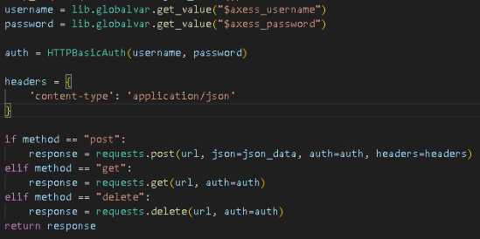
Access RESTful API in Python

Slide 6
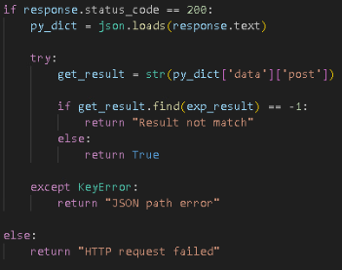
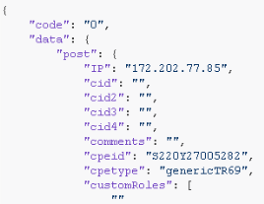
Handle Response JSON

Slide 7
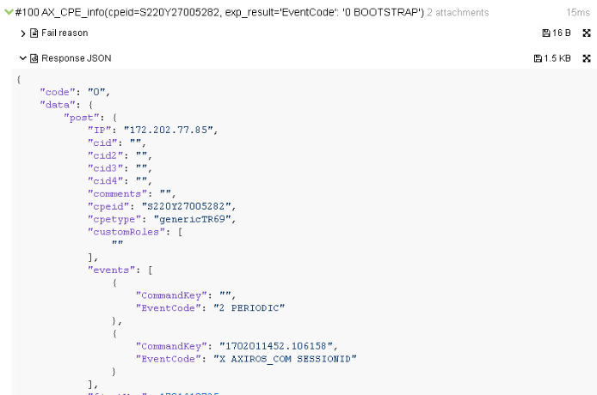
Debugging with Allure Report
！Report的JSON content顯示”雙引號，但Python檢查時要使用‘單引號

Slide 8
Advanced JSON Content Process
How to locate this node?

Slide 9
Advanced JSON Content Process
dict[‘data’][‘post’][‘events’][0][‘EventCode’]
0
1

Slide 10
Advanced JSON Content Process
lstEvent = dict[‘data’][‘post’][‘events’]
for event in lstEvent
event[‘EventCode’]
0
1

Slide 11
ACTS 3.0 TR APIs
Device Management
AX_CPE_info
AX_CPE_delete
Wait_for_CPE_Online
TR-069 Methods
TR069_AddObject
TR069_DeleteObject
TR069_Download
TR069_FactoryReset
TR069_GetParameterAttributes
TR069_GetParameterNames
TR069_GetParameterValues
TR069_GetRPCMethods
TR069_Reboot
TR069_ScheduleInform
TR069_SetParameterAttributes
TR069_SetParameterValues
TR069_Upload
TR-369 Methods
USP_Add
USP_Delete
USP_Get
USP_GetInstances
USP_GetSupportedDM
USP_GetSupportedProtocol
USP_Info
USP_Operate
USP_Set

Slide 12

Get response JSON
Return True(Boolean) on step passed
Or return error message(striing) on step failed
Get response JSON from VAR named with API name
Or send variable name with parameter var_name to save response JSON

Slide 13
Exercise
Configure CPE TR-069 to connect ACS server
Check CPE connected in ACS server
Put firmware file to Apache server in WAN_WKS
Upgrade CPE firmware with TR-069 Download method
Check CPE firmware version on ACS server

